Slide 1

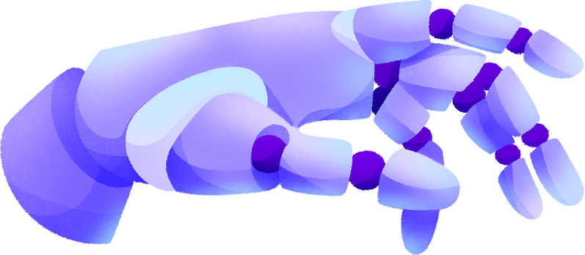


AI BASED X-RAY ANALYZER

Slide 2
TABLE OF CONTENTS
Introduction
Project Objectives
Idea/Approach
Tech Used
Conclusion
Reference

Slide 3

GEMINI
Gemini is Google's most powerful AI model yet, capable of understanding various inputs like text, images, and even video. Google AI Studio is a web-based platform where developers can easily experiment with Gemini's capabilities.
Gemini was announced and showcased on December 23, 2023

Slide 4
OBJETIVES
To create a user-friendly website that quickly identifies fractures in X-rays, offering clear and straightforward explanations, making it easier for anyone to understand their health status without complex medical terminology.

Slide 5


IDEA/APPROACH DETAIL
Utilized Gemini Vision Pro Selected a pre-trained model suitable for image recognition tasks as the starting point, customizing it to recognize patterns indicative of fractures and other relevant diseases in X-ray
Transferred the model to Google AI Studio for advanced fine-tuning.
Crafted detailed prompts to guide the model in identifying and distinguishing between different types of fractures and diseases visible in X-ray images.
Designed a user-friendly website interface that allows users to easily upload X-ray images for analysis. The website provides clear, understandable results indicating the presence of fractures or diseases, making the tool accessible and useful for both medical professionals and the general public.

Slide 6
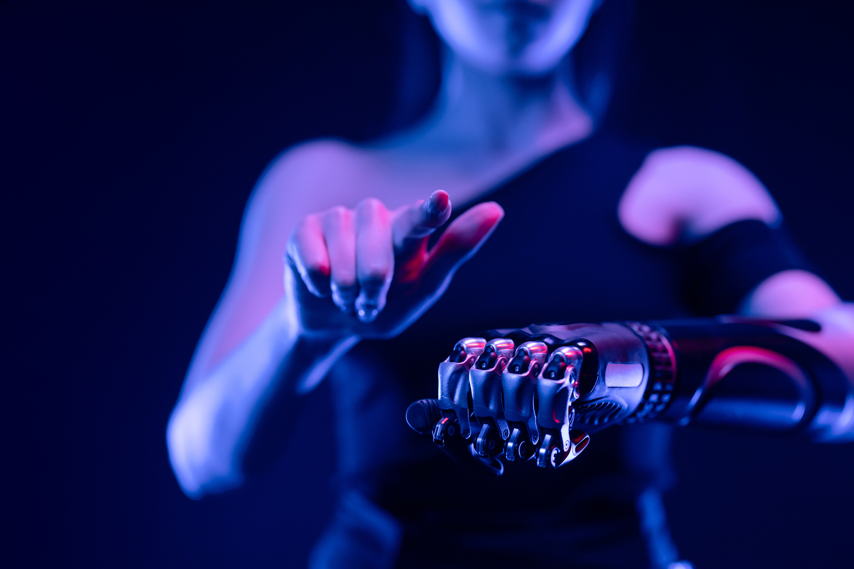
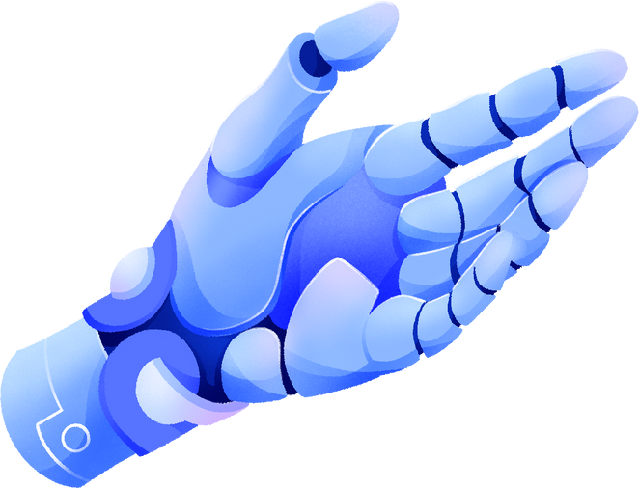
TECHNOLOGY STACK
1) Frontend Development:
HTML
CSS
JAVASCRIPT
2) Backend Development:
Python
Flask
Gemini
Google AI Studio

Slide 7




CONCLUSION
This project successfully harnesses the synergy of web development and artificial intelligence technologies to create an innovative, AI-powered X-ray analysis tool, significantly advancing the accuracy and efficiency of fracture detection in medical diagnostics.
01
The ongoing need for such technological innovations is clear, as they hold the potential to revolutionize healthcare by improving diagnostic speed and accuracy, ultimately leading to better patient outcomes and more accessible healthcare services in the future.
02

Slide 8
References
https://ai.google.dev/docs

Slide 9


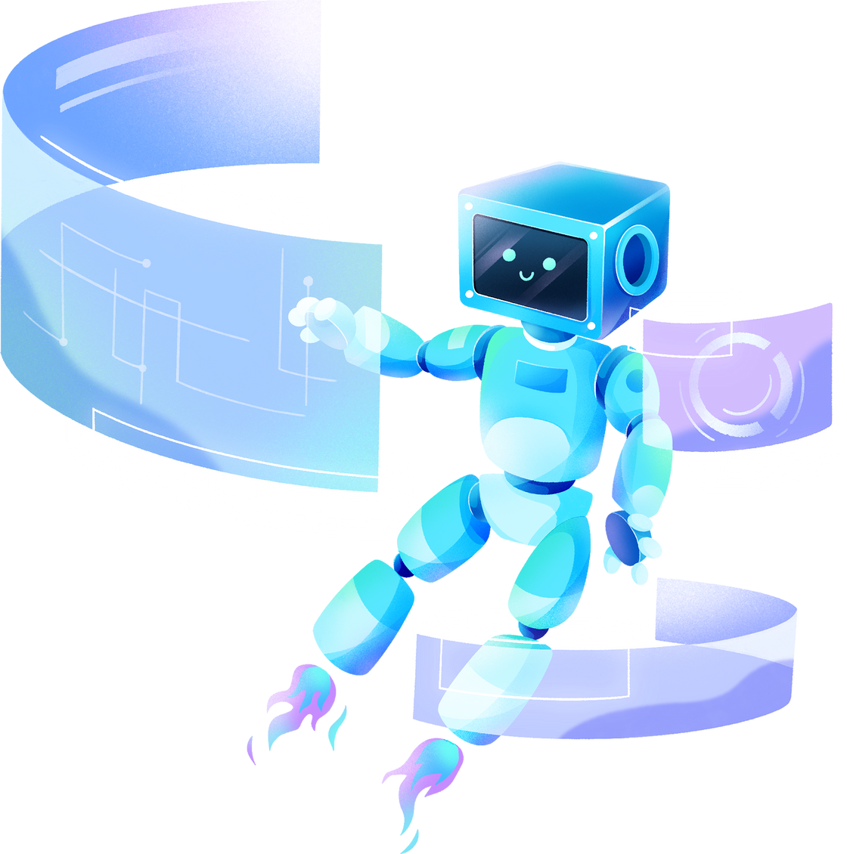
THANK YOU!
PRESENTED BY: HACKIEE

